Slide 1
Review for Quiz 3
Topics:
linear models
extending linear models by transformation
over fitting and regularization
dimensionality reduction
PCA
Genetic algorithms

Slide 2
Question: 2 classes are distinguished by a threshold values of a linear combination
of d attributes. Explain how h(w|x) = sign(w^{T}x) becomes a hypothesis set for linear
binary classification in this type of problem.

Slide 3
Question: We have used 1-step optimization in 4 ways:
polynomial regression in 1D (curve fitting)
multivariate linear regression
extending linear models by transformation
regularization by weight decay
2 of these are equivalent; which ones

Slide 4
Question: 1-step optimization requires the in-sample error to be the
sum of squared residuals. Define the in-sample error for following:
multivariate linear regression,
extending linear models by transformation
extended linear models with regularization by weight decay

Slide 5
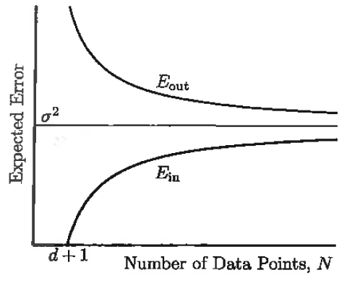
Interpret the “learning curve” for multivariate linear regression when
training data has normally distributed noise
Why does E_{out} approach σ² from above? linear model P13
Why does E_{in} approach σ² from below?
Why is E_{in} not defined for N<d+1?

Slide 6
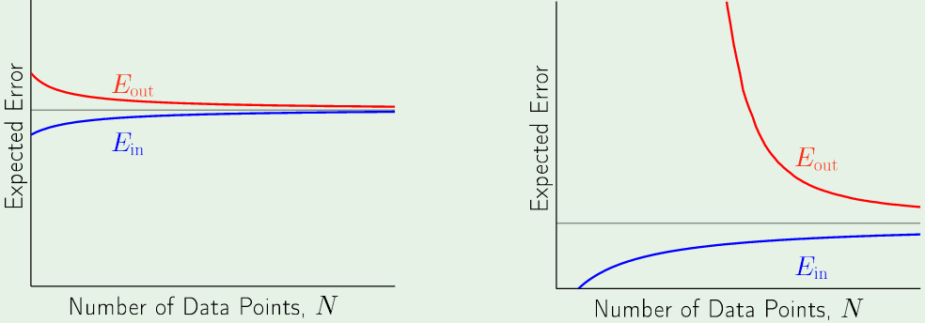
What do these learning curves say about
simple vs complex models

Slide 7
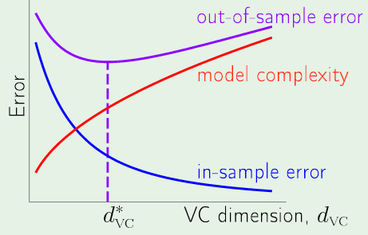
Since we can never know what d*_{VC} is, how do we estimate a good level of
complexity without sacrificing training data?

Slide 8
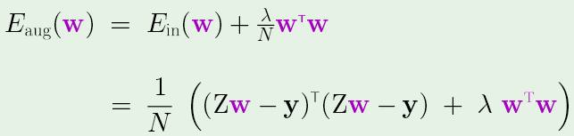
E_{val} plays the same role in weight decay and tuning polynomial regression but E_{in} behaves
differently. How is the behavior of E_{in} different and why?

Slide 9
Stochastic gradient decent: correct weights by error in each data point

Slide 10
PCA
I want to perform PCA on a dataset. What must I assume about the noise in data?
Dimension reduction p4

Slide 11
More PCA
Correlation coefficients of normally distributed attributes x are zero. What can we say about the covariance?
Dimension reduction p4

Slide 12
More PCA
z_{k} is the a feature defined by projection of attributes in the direction of the eigenvector w_{k} of the covariance matrix.
How is z_{k} related to attributes?
What are the mean and variance of z_{k} ?
Use the eigenvalue equation to prove that eigenvalue λ_{k} is the variance of z_{k}
Dimension reduction p12
Lecture Notes for E Alpaydın 2010 Introduction to Machine Learning 2e © The MIT Press (V1.0)
12

Slide 13
What is the difference between fitness and selection probability of
chromosomes?

Slide 14
How do I design a roulette wheel for chromosome selection?

Slide 15
A spin of the roulette wheel returns uniformly distributed random number 0.43.
How do I find the chromosome that is selected?

Slide 16
The chromosome of one parent is all zeros
The chromosome of the other parent is all ones.
3 sites are selected for crossover.
Find the chromosome of the next generation

